Slide 1

Music recommendation system

Slide 2
Problem formulation
I had to build a model which fits to user’s musical preferences to recommend them music they should listen to.
Inputs (is taken via UI):
1. Favourite genres
2. Favourite artists of these genres
3. Some songs that user already likes
Outputs:
Some songs you probably should listen to :)

Slide 3

Problem formulation
I had to build a model which fits to user’s musical preferences to recommend them music they should listen to.
Inputs (is taken via UI):
1. Favourite genres
2. Favourite artists of these genres
3. Some songs that user already likes
Outputs:
Some songs you probably should listen to :)

Slide 4
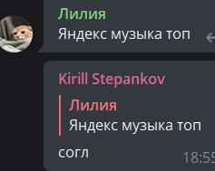
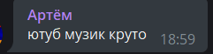
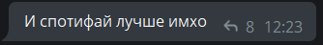
Why?
The underlying business motivation is obvious: we make people use our music service, the main profit – paid subscription. If music recommendation system fits well to user’s tastes then he is most likely to stay, otherwise user will think to go away.
There’s no universal solution created for now, we have no ‘best’ system yet, opinions differ. So any recommendation system that will make a significant breakthrough would be very competitive, despite Yandex Music, Spotify, YouTube Music already exist.

Slide 5

Data
Yandex Music API unofficial
5m email rows were found
500 000 were Yandex users, where ~20% had a Yandex Music account, where ~33% had enough liked tracks to consider.
2. Took all artists, whose tracks they had liked.
3. Took data of all tracks of those artists
Total data gathered before preprocessing: 2.2m tracks data,
3.3k unique users, 600k users added tracks.

Slide 6
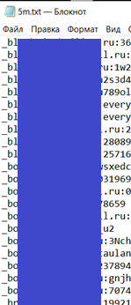
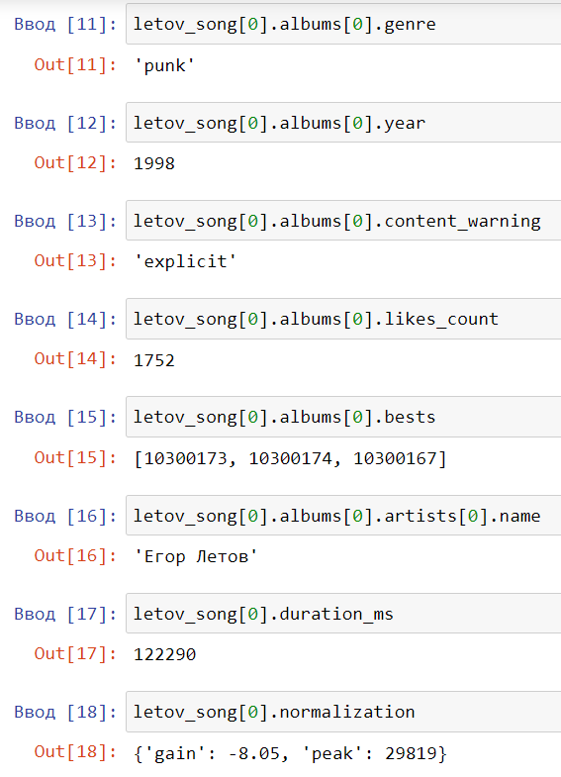
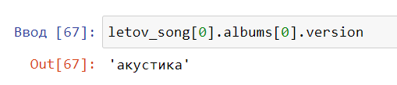
Data

Slide 7
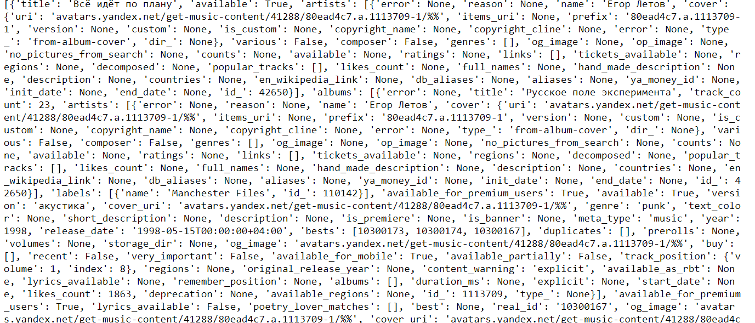

Slide 8
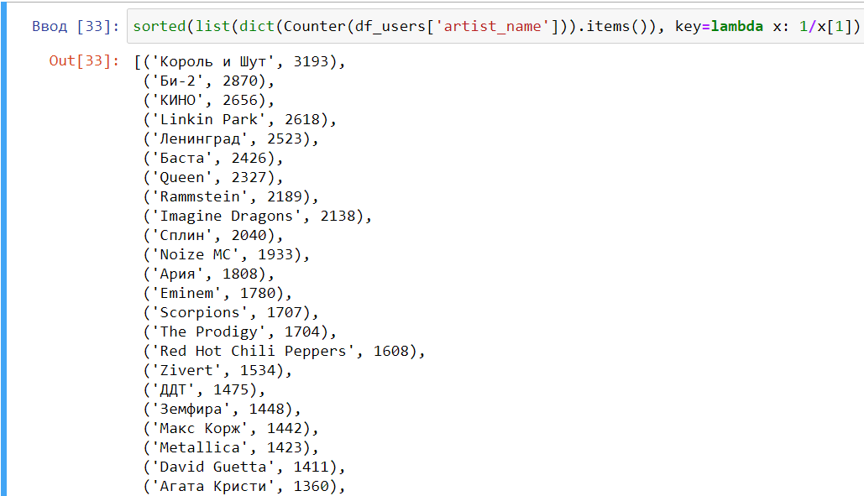
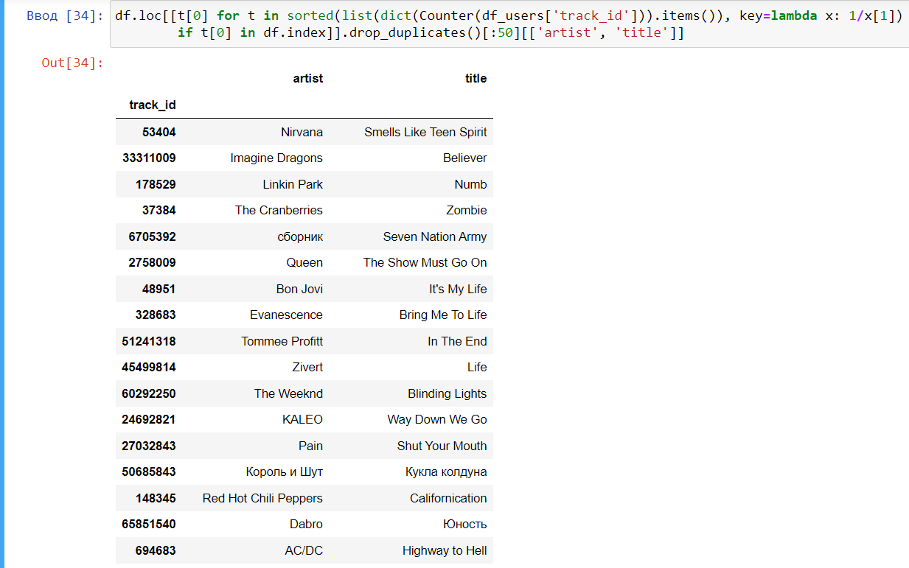
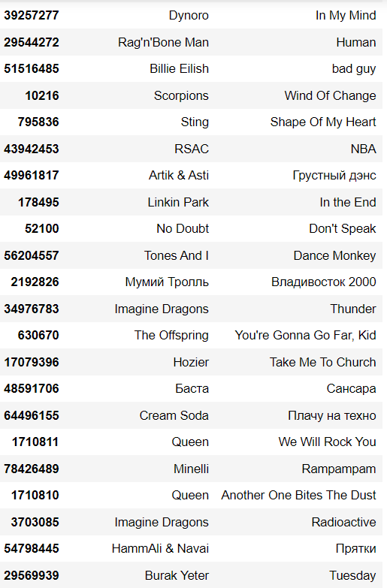
Interesting facts!
8/15 the most known and popular artists are Russian, but only 11/50 the most popular songs are Russian too

Slide 9
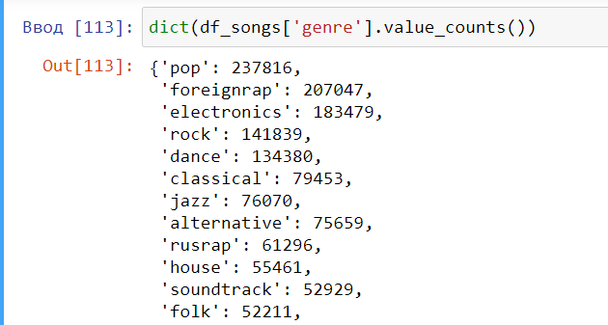
Interesting facts!
Classical music is in top-10 of most popular surround Yandex Music users

Slide 11
MODELS

Slide 12
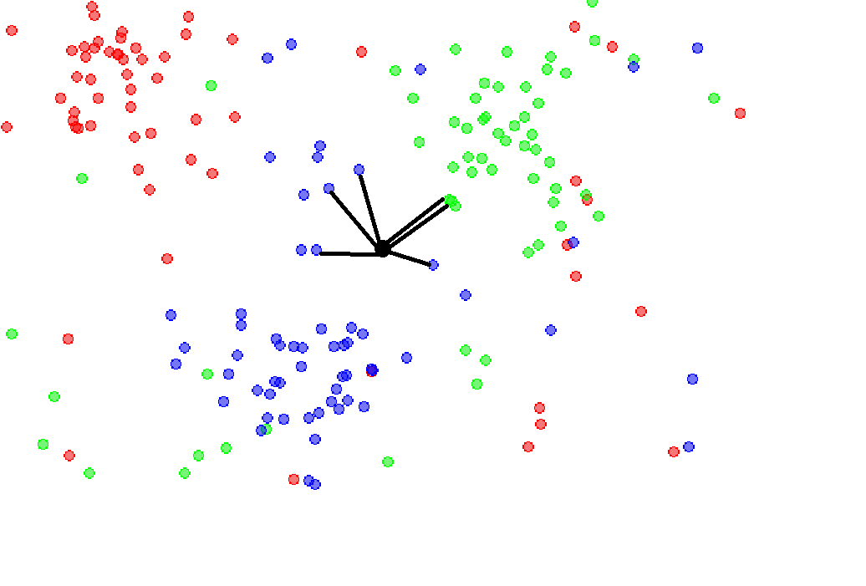
Approach 1: KNN
Take average of all tracks liked by user
Find k nearest neighbors
You’re great!?

Slide 13
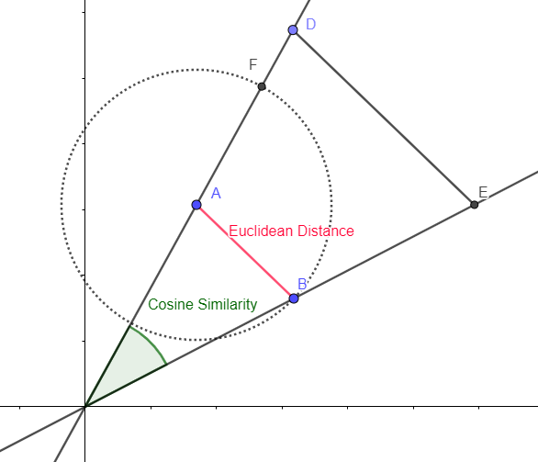
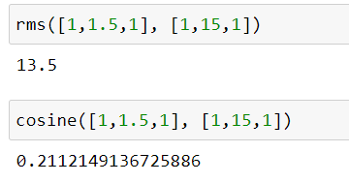
What’s wrong?
genre_pop, likes_count, is_calm, …
Song1 1 1.5 1
Song2 1 15 1

Slide 14
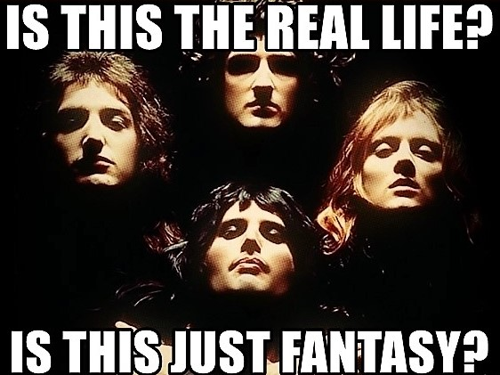
Real life?
Music taste may change by time…
Way more hidden features in tracks
What if there’s too little input data?
Human perception!

Slide 15
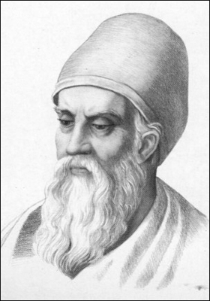

Let’s think…
Euclidean distance -> cosine distance (based on dot product)
Consider time-based track relevance
Try to find similar users!
Create coldstart model

Slide 16
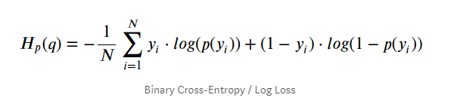
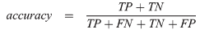
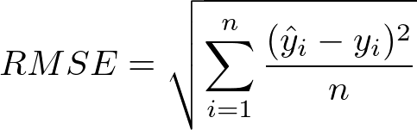
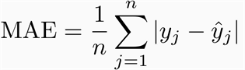

Metrics
?
?
Loss function: ?
Metric: ?
Regularization: ?
Cross-validation:?
?
Internal measurer:
Coldstart model coefficient
User taste relevance vs time
User-based song weight determiner

Slide 17



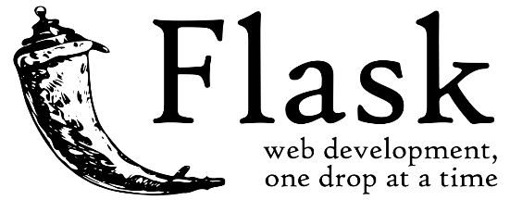

Deployment
I built a web application that copies Yandex Music design a lot for handy usage and demonstration.
Flask + MongoDB + HTML/CSS/JS

Slide 18
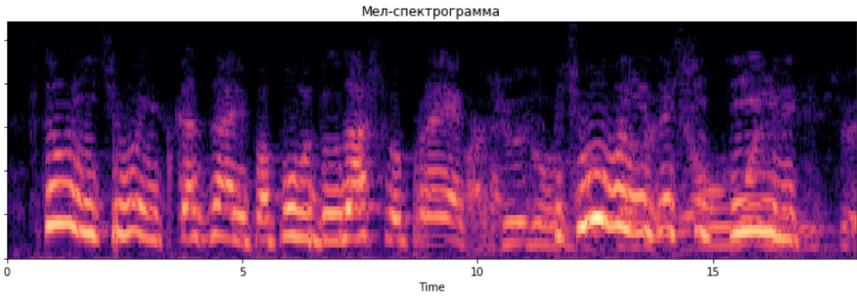

To be done!
To be done!
There’s for certain a lot of things to explore.
Main idea – improve content-based heuristic, analyze musical files to generate way more features that really illustrate content.
BPM
Key (Major/Minor)
Calm/Enegretic
Reverb level
Modulations/borrowed chords etc.
Chords

Slide 19
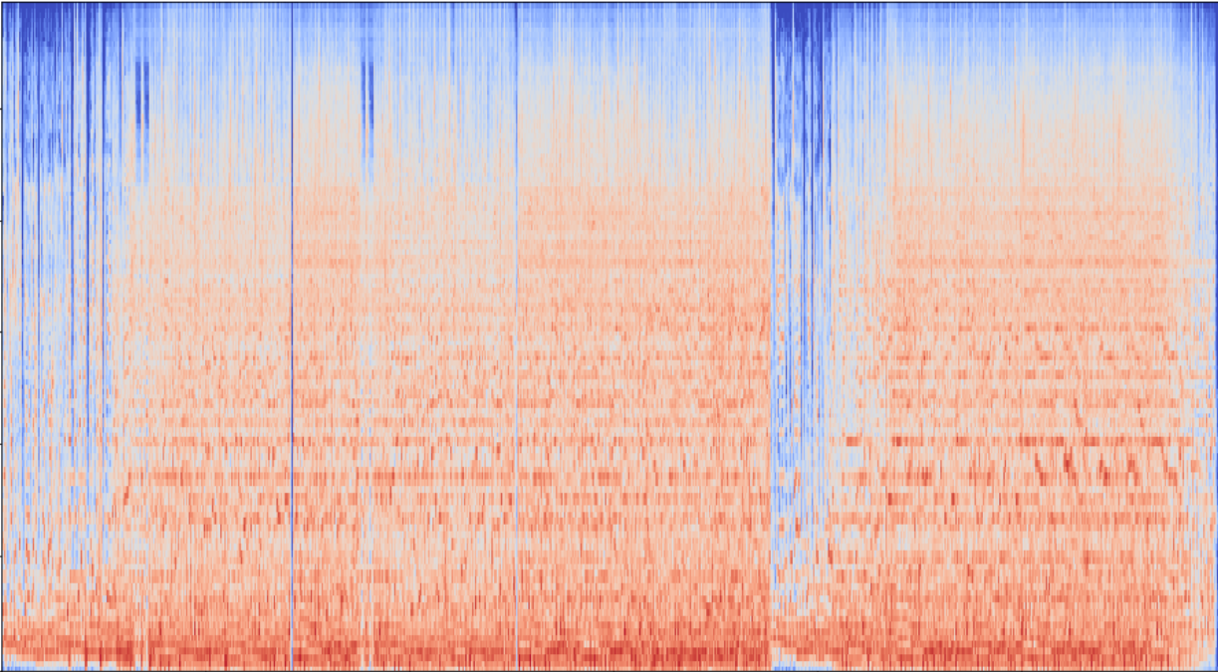
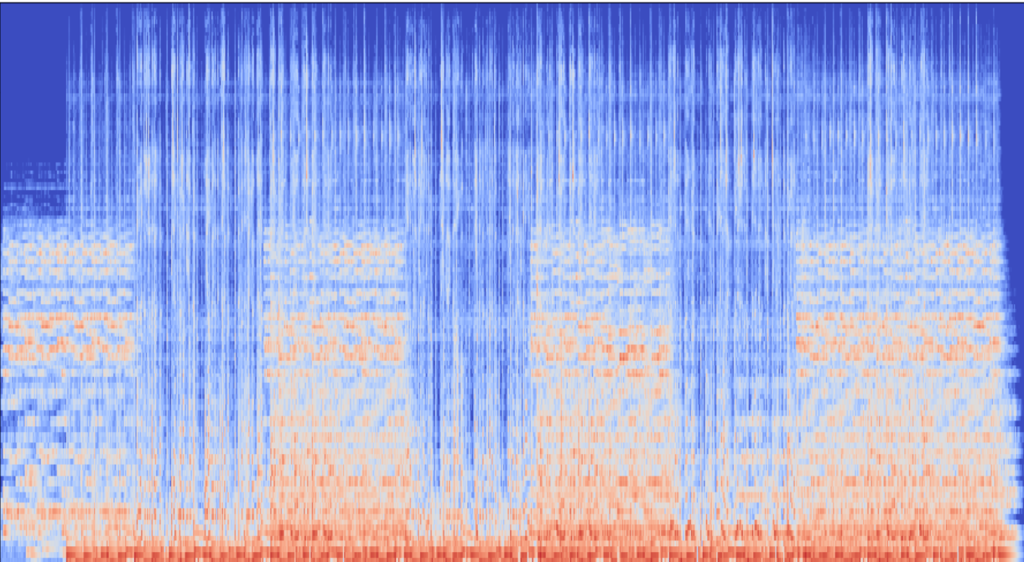
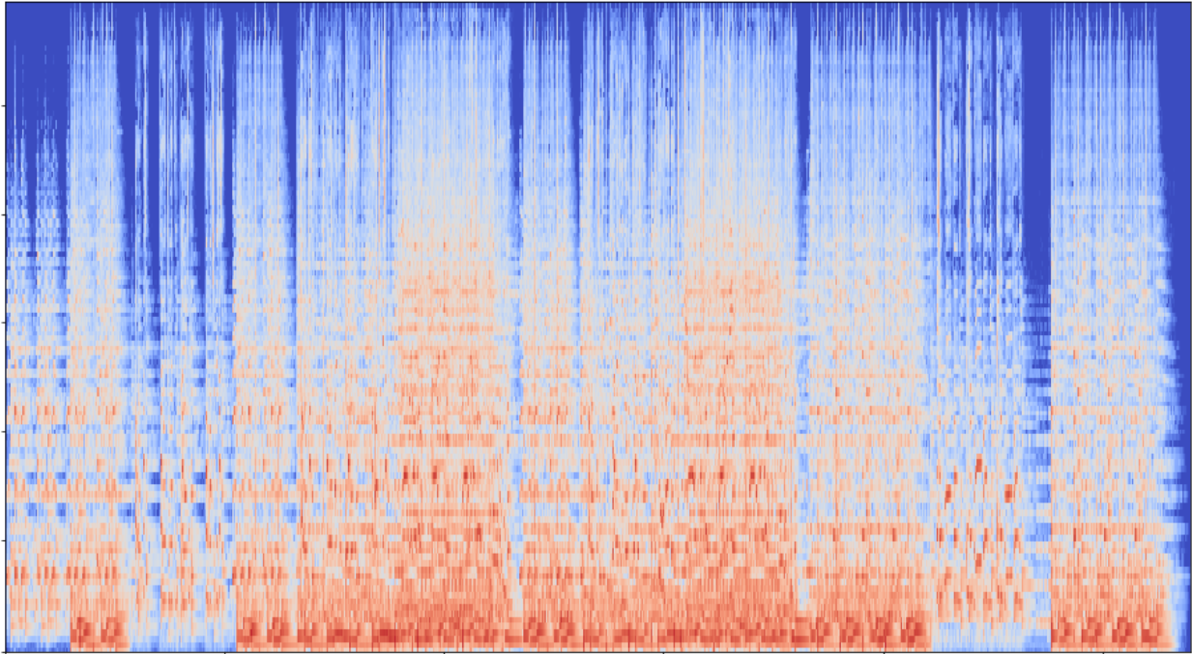
My Chemical Romance – Famous Last Words
Cigarettes After Sex - K
Coldplay - Trouble

Slide 21

Thanks for attention!

